Slide 1
Algorithm Design for Multi-resolution Overlay Measurement Initial Simulation Result
05/06/2014

Slide 2
Outline
Simulation Set-Up
Simulation Results
Next Steps

Slide 3
Simulation Set-Up (I)
Use Matlab to implement the proposed algorithm
Synthetic Underlay Network
random graph generated by using GT-ITM (10 nodes, 100 nodes graph)
Randomly select a subset of underlay nodes as overlay nodes
Underlay path between each overlay node pair: shortest path algorithm
exclude underlay links that are not traversed by any overlay pair (they cannot be covered by overlay probing)

Slide 4
Simulation Setup (II)
Each underlay link e fails or becomes congested according to a fixed probability α_{e,} different links have different probabilities, following one of the three distributions:
α_{e} is randomly chosen between 0 and 0.3
α_{e} follows a Normal Distribution with mean 0.05 and standard deviation of 0.1 - N(0.05, 0.1²)
α_{e} takes one of the three values: 70% links have probability of 0.01, 20% links have probability of 0.05, 10% links have probability of 0.20
Target underlay link coverage number n_{e} is determined by its failure probability:
1 if prob ∈ (0, 0.1), 2 if prob ∈ (0.1, 0.2), 3 if prob ∈ (0.2, 1)
Use Greedy Algorithm 3 to find a subset of overlay node pairs to conduct probing

Slide 5
Simulation Set-Up (III)
Generate 1000 underlay network failure/congestion scenarios using 1000 simulations
In each simulation, generate random failure/congestion on each underlay link according to the underlay link’s failure/congestion probability α_{e}
calculate the corresponding overlay link statuses between the chosen overlay node pairs.
Base on overlay link statuses, use Maximum Likelihood Estimation or Bayesian Inference Model to infer underlay link statuses
Compare the inferred status with the actual status for each underlay link:
Correct Prob: the link inference is correct
False Positive Prob: When the actual link status is on/normal, the inferred status is off/abnormal
False Negative Prob: When the actual link status is off/abnormal, the inferred status is on/normal

Slide 6
Simulation Results (I) Maximum Likelihood Estimation
 | 100 Nodes Graph (Overlay Node 40) |  |  | 10 Nodes Graph (Overlay Node 6)
Number of Original Underlay Links | 174 |  |  | 12
Number of Underlay Link Covered by Overlay Probing | 138 |  |  | 12
Number of Chosen Overlay Node Pairs | 80 | 152 | 89 | 8 | 14 | 9
Underlay Link Failure Probability | Random Distribution | Normal Distribution | Three-Classes | Random Distribution | Normal Distribution | Three-Classes
Correct Probability | 0.9819 | 0.9586 | 0.9998 | 0.9836 | 0.9207 | 0.9958
False Positive Probability | 0.0076 | 0.0110 | <0.0001 | 0.0074 | 0.0380 | 0.0001
False Negative Probability | 0.0105 | 0.0304 | 0.0001 | 0.0090 | 0.0413 | 0.0036

Slide 7
Simulation Results (II) Maximum Likelihood Estimation
 | 100 Nodes Graph (Overlay Node 40) |  |  | 10 Nodes Graph (Overlay Node 7)
Number of Original Underlay Links | 400 |  |  | 40
Number of Underlay Link Covered by Overlay Probing | 202 |  |  | 16
Number of Chosen Overlay Node Pairs | 122 | 206 | 130 | 15 | 18 | 15
Underlay Link Failure Probability | Random Distribution | Normal Distribution | Three-Classes | Random Distribution | Normal Distribution | Three-Classes
Correct Probability | 0.9775 | 0.9710 | 0.9996 | 0.9960 | 0.9794 | 1
False Positive Probability | 0.0097 | 0.0080 | <0.0001 | 0.0019 | 0.0079 | 0
False Negative Probability | 0.0127 | 0.0210 | 0.0004 | 0.0021 | 0.0127 | 0

Slide 8
Simulation Results (III) Comparison of Two Methods
 | Maximum Likelihood Estimation |  |  | Bayesian Inference Model (ɳ = 0.02)
Number of Original Underlay Links | 40
Number of Underlay Link Covered by Overlay Probing | 19
Number of Chosen Overlay Node Pairs | 17 | 20 | 17 | 17 | 20 | 17
Underlay Link Failure Probability | Random Distribution | Normal Distribution | Three-Classes | Random Distribution | Normal Distribution | Three-Classes
Correct Probability | 0.9978 | 0.9938 | 1 | 0.9779 | 0.9724 | 1
False Positive Probability | 0.0002 | 0.0002 | 0 | 0.0221 | 0.0273 | 0
False Negative Probability | 0.0021 | 0.0060 | 0 | 0 | 0.0004 | 0

Slide 9
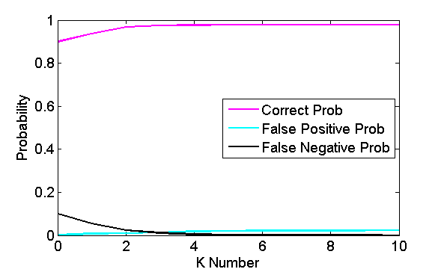
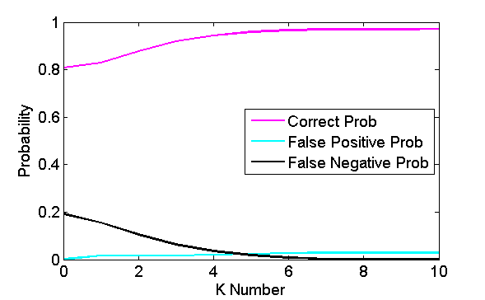
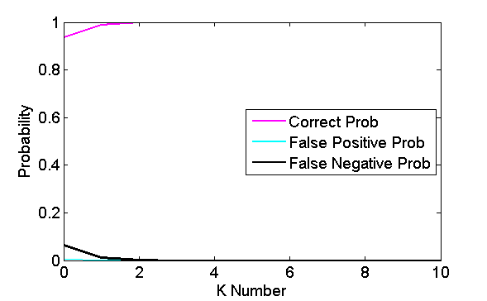
Bayesian Inference Model -- varying K Number
Random Distribution
Normal Distribution
Three-Classes

Slide 10
Simulation Results (IV) Comparison of Two Methods
 | Maximum Likelihood Estimation |  |  | Bayesian Inference Model (ɳ = 0.02)
Number of Original Underlay Links | 400
Number of Underlay Link Covered by Overlay Probing | 197
Number of Chosen Overlay Node Pairs | 128 | 213 | 133 | 128 | 213 | 133
Underlay Link Failure Probability | Random Distribution | Normal Distribution | Three-Classes | Random Distribution | Normal Distribution | Three-Classes
Correct Probability | 0.9855 | 0.9627 | 0.9991 | 0.9486 | 0.9026 | 0.9886
False Positive Probability | 0.0057 | 0.0098 | 0.0001 | 0.0514 | 0.0955 | 0.0105
False Negative Probability | 0.0088 | 0.0275 | 0.0008 | 0 | 0.0019 | 0.0009

Slide 11
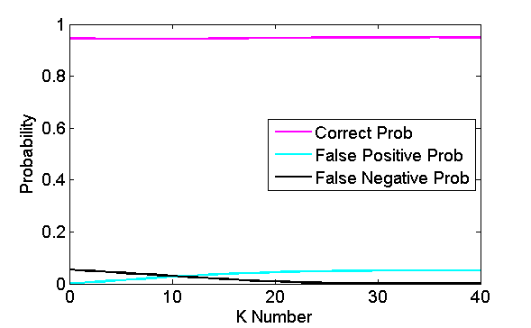
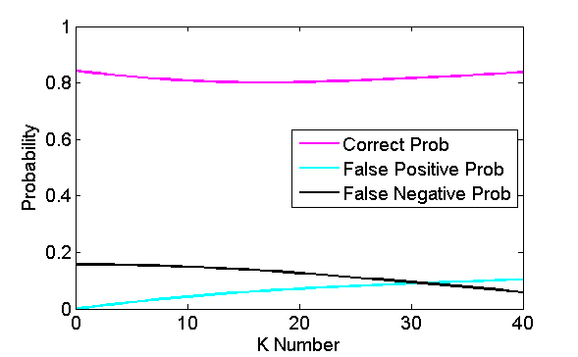
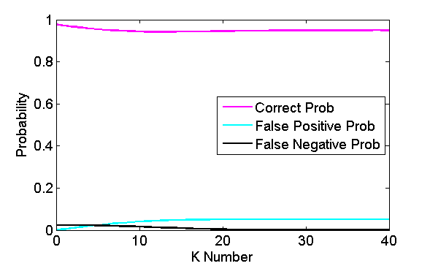
Bayesian Inference Model -- varying K Number
Random Distribution
Normal Distribution
Three-Classes

